Slide 1

Steven
Involved

Slide 2

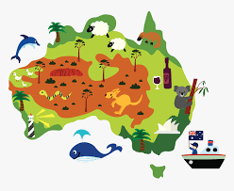


Backgrounds :
After he’s past his BAC he went to Australia for a gap year. He spent two years in college majoring computer sciences then left because “that was boring”.
Then worked in interim for two years before getting back into his studies as Game Designer but couldn’t find a job.
So he started this training.

Slide 3
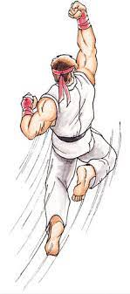

Strengths:
-Very strong at street fighter (ryu)
-Self-taught / Independant
Flaws:
Troubles for step back

Slide 4

Compare to music :
Everybody gotta learns sometimes (the korgis)
Because it’s a good song

Slide 5


2 noteworthy:
-When he started his IT journey -When he mets his girlfriend
-

Slide 6


Favorite websites, apps …:
-Twitch
-Discord

Slide 7


Experiences on IT:
-Game development (c++, c#, blueprint, unreal engine)
-Visuals (photoshop, premiere)

Slide 8

I say english, what do you say?
Colonial empire.

Slide 9
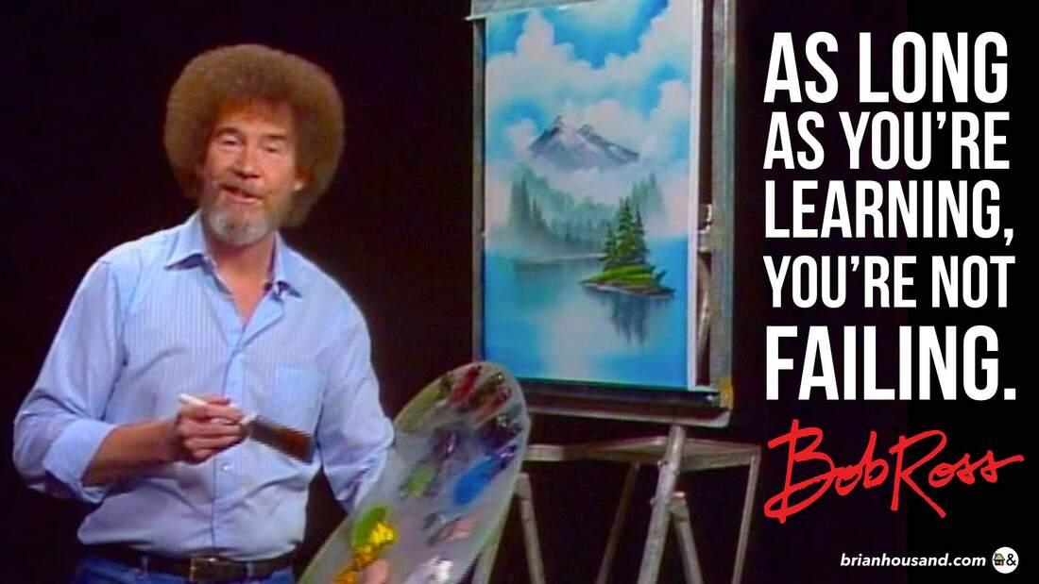
Proverbs:

